Slide 1



Mrinal Rai Vidushi Garg Riteeka Ratnakar
Aashay Tiwari

Slide 2
Agenda
Skeleton Plane & Surface Plane
Google Design Material
UX Principles
UX Research Methods
IBM Design Thinking
Style Guide

Slide 3

Summary
We have designed a mobile application where any one can register with us to get their events planned and executed without any hustle or burden on themselves.
The user can see the list of events around his location and can book a seat for himself and invite his friends as well.
VenYou provides unique solution to customers who want to coordinate their events by setting their own theme.

Slide 4
Summary
Host event by the organizers for e.g. – DJ, entrepreneur, singer etc.
Sort and filter the events based on genre, location, date
Interactive maps/ location to see the location of event and book the cab till location
Live newsfeed of event happening currently
Reminder through app notification
Provide commute options to venue and vice versa
Adding list of invitees to the event, create a group and add members
Paperless tickets with QR code embedded in the app, no need to take printouts

Slide 5
Skeleton Plane
Skeleton determines the visual form on the screen, presentation and arrangement of all elements that makes us interact with the functionality of the system that exist on the interface.
Also how the user moves through the information, and how information is presented to make it effective, clear, obvious.
Wireframes are widely used to create a visual format, which is a Static diagrams that represent a visual format of the product, including content, navigation and ways for interactions.

Slide 6

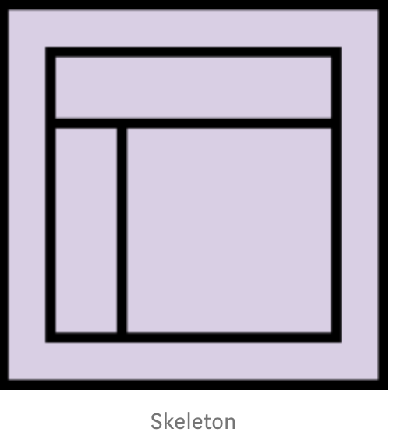
It is divided into three components-
Interface Design presenting and arranging interface elements to enable users to interact with the functionality of the system.
Navigation Design how to navigate through the information using the interface.
Information Design defines the presentation of information in a way that facilitates understanding.
So, the Skeleton should answer these questions:
What visual form of all things that will be presented on screen
How interactions will be presented and arranged
How will users move around the site, or application
How content will be presented clearly

Slide 7
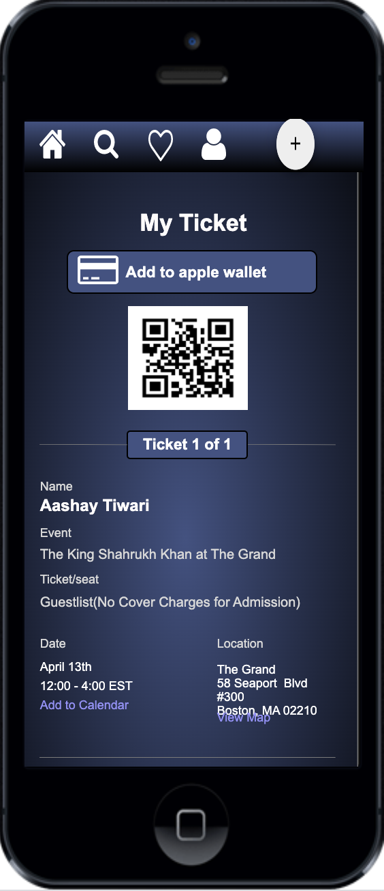
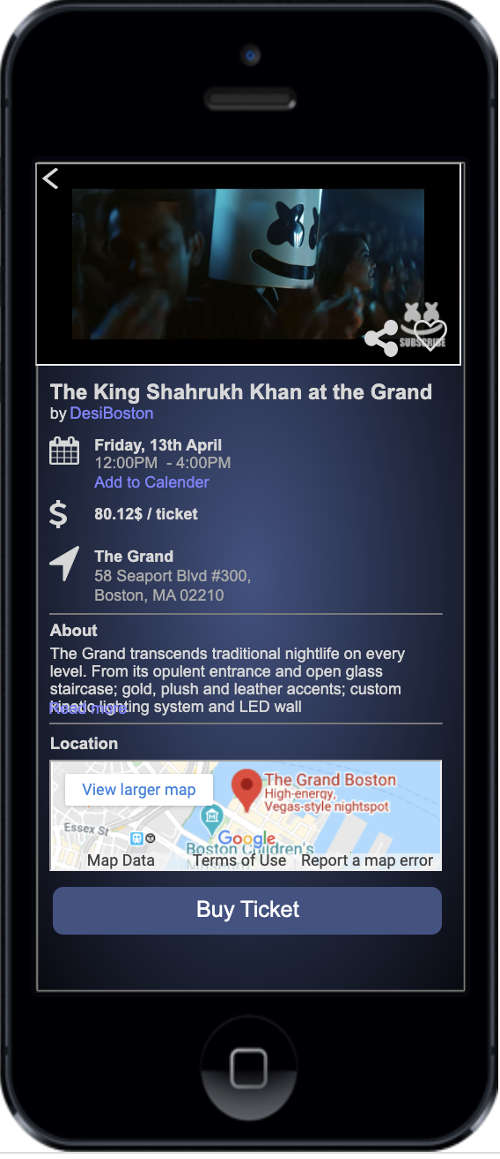
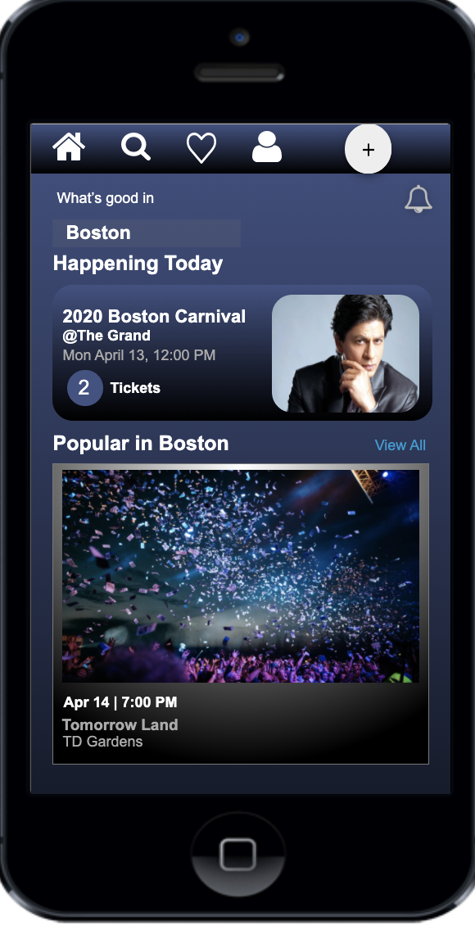
Interface Design
Navigation Design
Information Design

Slide 8


Surface Plane
In this plane, we’ll decide on the colors, fonts, graphics, sounds and images which will be experienced by the user on the surface. These sensory creations will not only serve to define the aesthetics of our project, but rather to enable best possible usability. For example, by coloring a button light blue on a page with mostly black, dark blue and white elements we could emphasize this button’s importance.
It’s planned to adopt Google’s Material Design principles and to apply the Angular Material Design library. This may eventually have an influence on the decisions made on the skeleton and / or the surface plane.

Slide 9
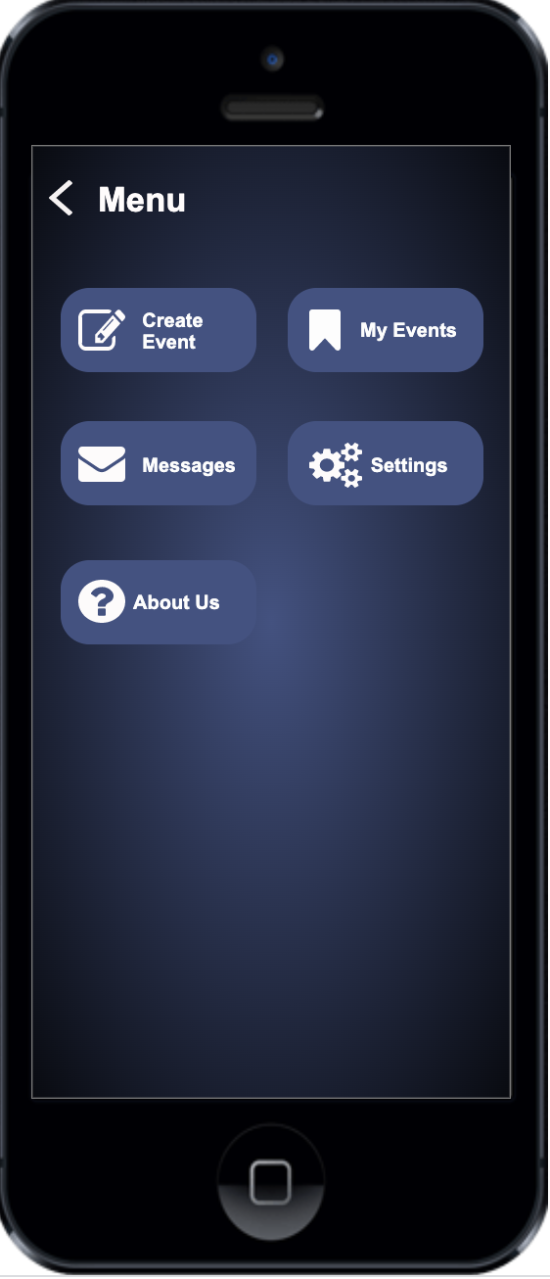
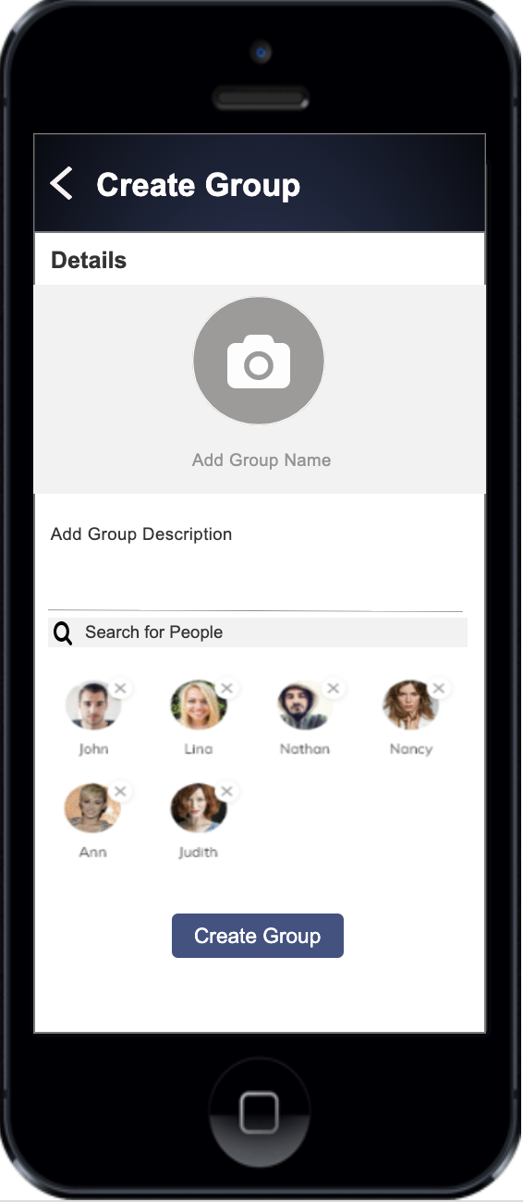

Slide 10
Google Design Material
Material is an adaptable system of guidelines, components, and tools that support the best practices of user interface design.
Color : The first thing that came over my mind is the color. At material.io you can find the color tool which contains “Material Palette” — selected colors by Material Design. Additionally, to ensure all colors on an interface fall into the same color theme, we assigned buttons with colors opposite to users’ common sense.
Interactive Buttons : An emphasis on user actions(buttons) makes core functionality immediately apparent and provides waypoints for the user
Groups
Predictive Search

Slide 11
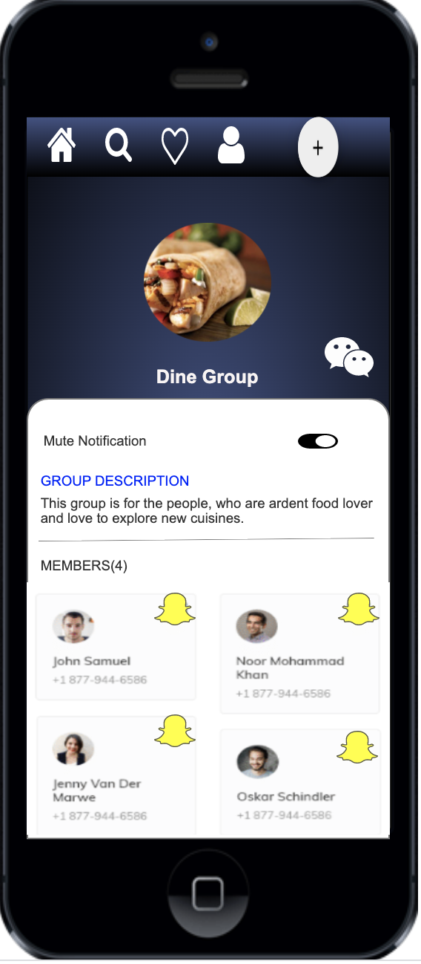
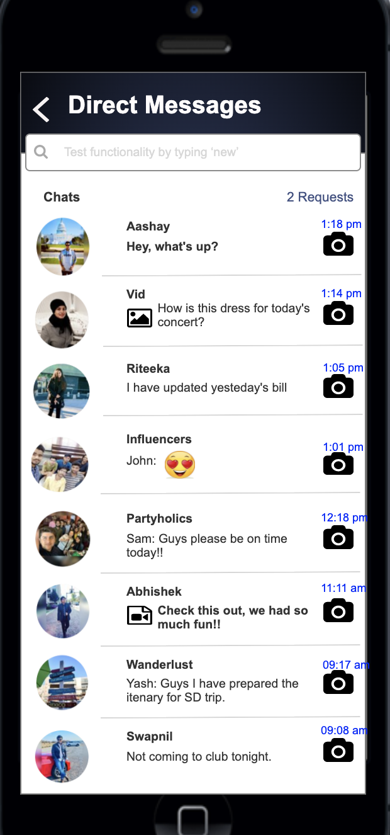

Slide 12
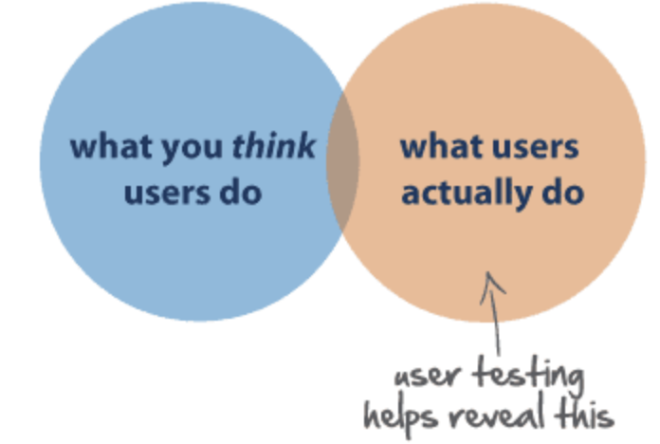
UX Principles
Meet the user needs:
In a half of a second, users evaluate the design of an app, so you need to decide what you want users to do and make it apparent. Don’t make it difficult to find action buttons. Visually focus attention on the main button versus a bunch of buttons on the home page.

Slide 13

Use Simple Language
Just as simplicity has become a best practice in visual design, UX-focused copywriting should avoid technical terms and opt for simple language. Users are busy, they’re on the go, they’re multi-tasking, so use words in your design that are closest to the user’s thoughts.
Have a clear hierarchy
It is easy to take hierarchy for granted, but it is a UX principle that ensures smooth navigation throughout a design. There are two chief hierarchies that you need to note. First comes the hierarchy that is associated with how content or information is organized throughout the design.
Keep it Consistent
Users expect apps to share some similarities with other apps they regularly use. This makes it easy for them to become familiar with the new app without any additional learning costs.
Usability first
Any app that is cluttered is bound to lose visitors. As a designer, your job is to make sure that each icon, button, and snippet of information that is present within the design has a purpose.
Feedback Matters
Design should be interactive by nature. So, when a user clicks on something, he’ll need a response from the app to understand that his command has been received. Feedback is a crucial way to encourage communication between humans and machines.
Know the Audience
You must have a good idea of who the audience is for the intended website or app before you create it. How to best design the interface will come from them.

Slide 14
QA and Testing Manual Test Cases

Slide 15
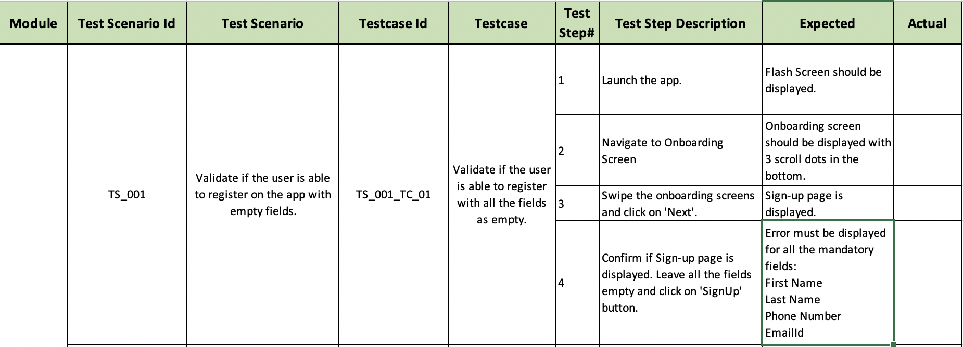
Test Case - 1

Slide 16
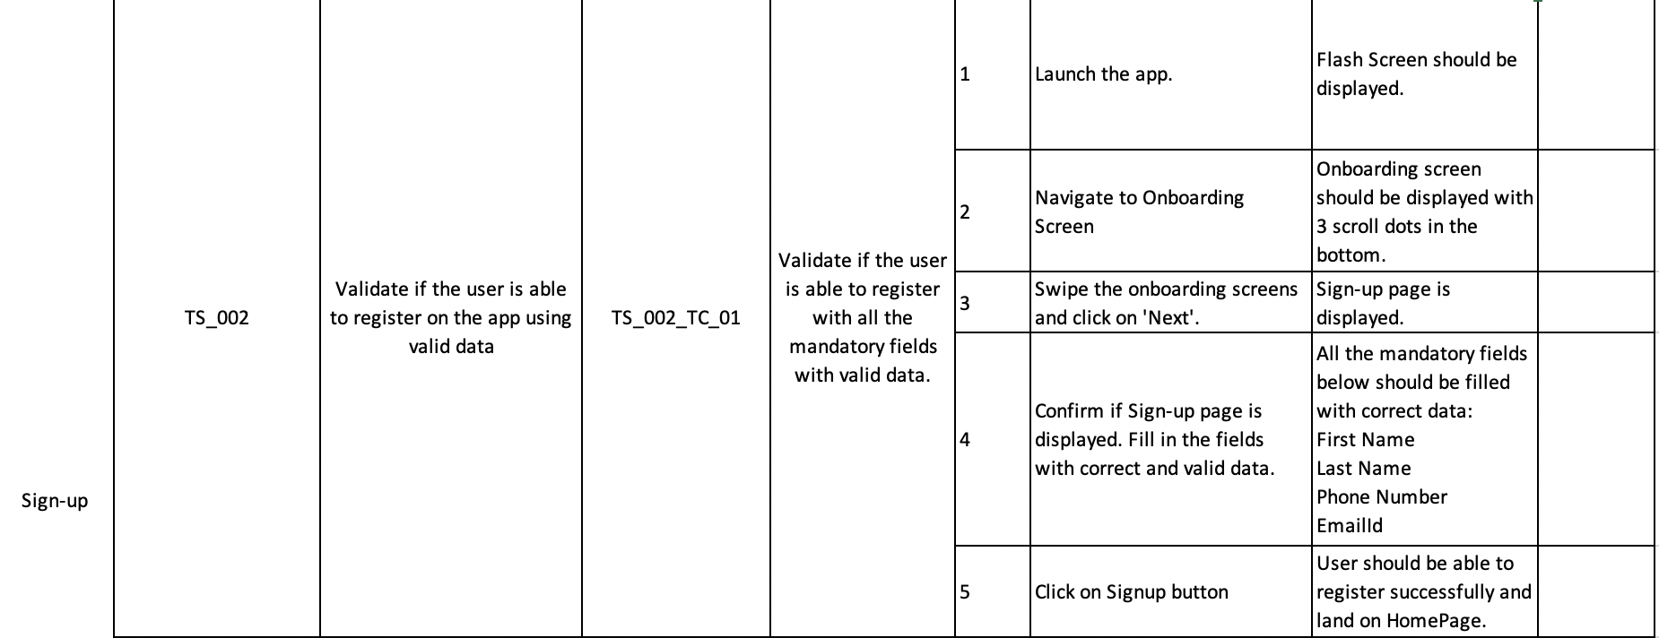
TEST CASE - 2

Slide 17
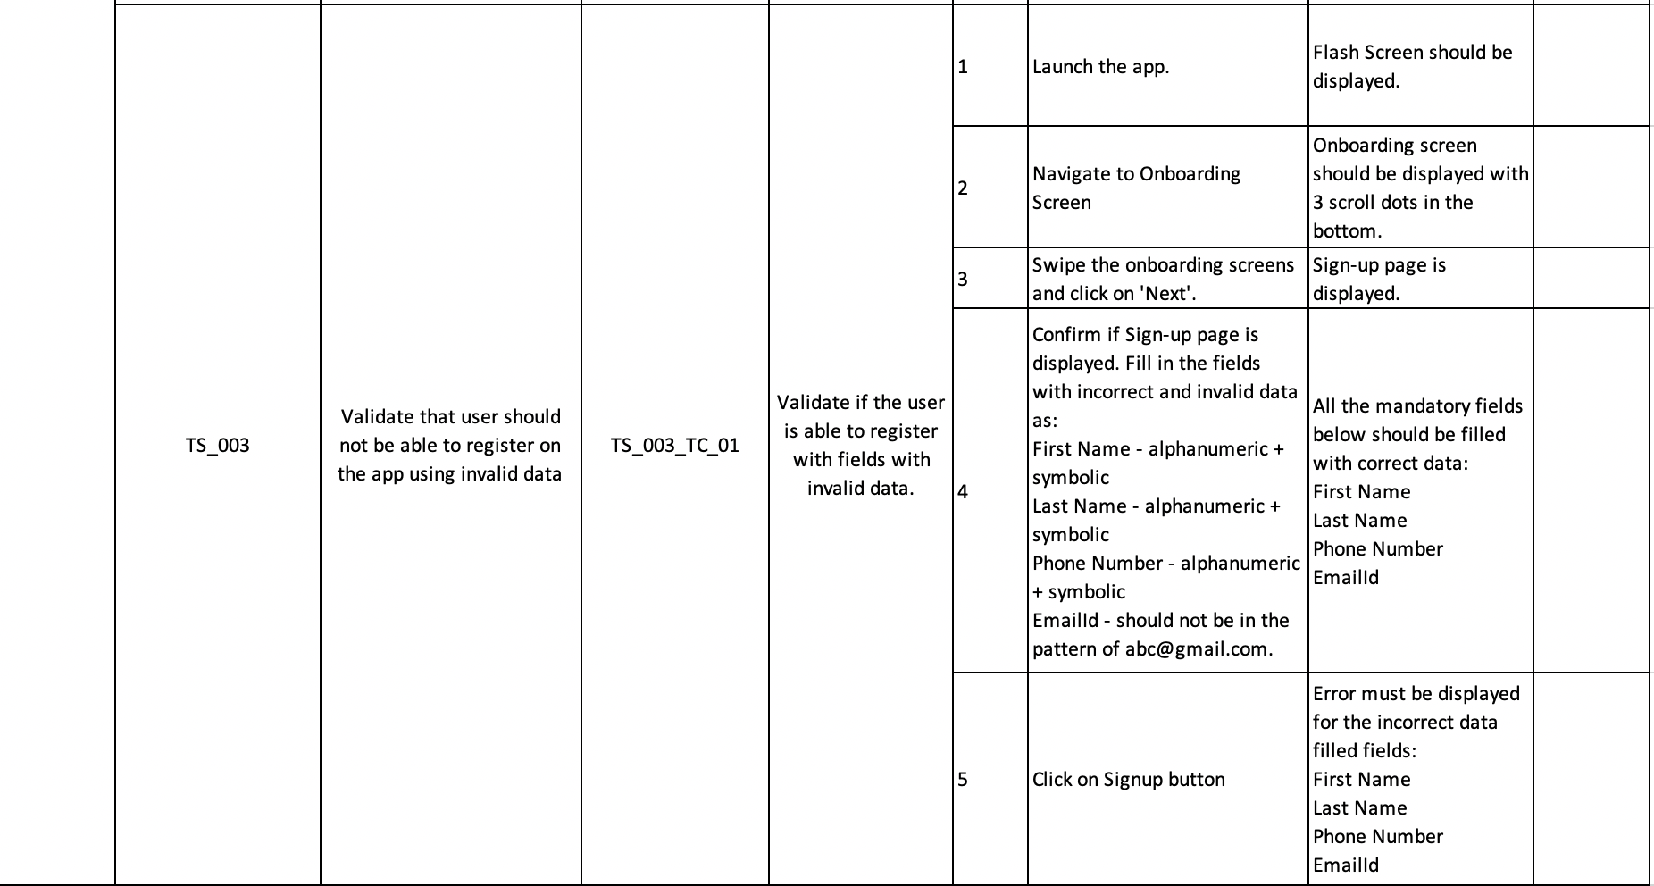
Test Case - 3

Slide 18
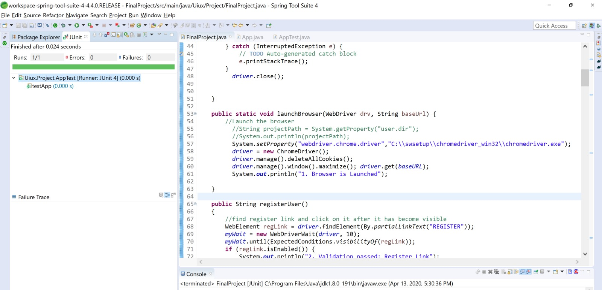
Selenium Testing

Slide 19
UX Research Methods

Slide 20
Surveys and Questionnaires
https://docs.google.com/forms/d/e/1FAIpQLSdXfyVvGBlR_GXdUyAIcElAZsjTHq7tnZlG4v8oShFOo3Kg/viewform?usp=sf_link

Slide 21
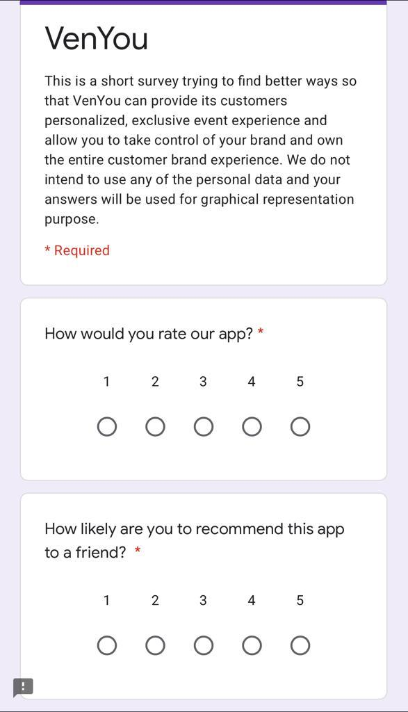
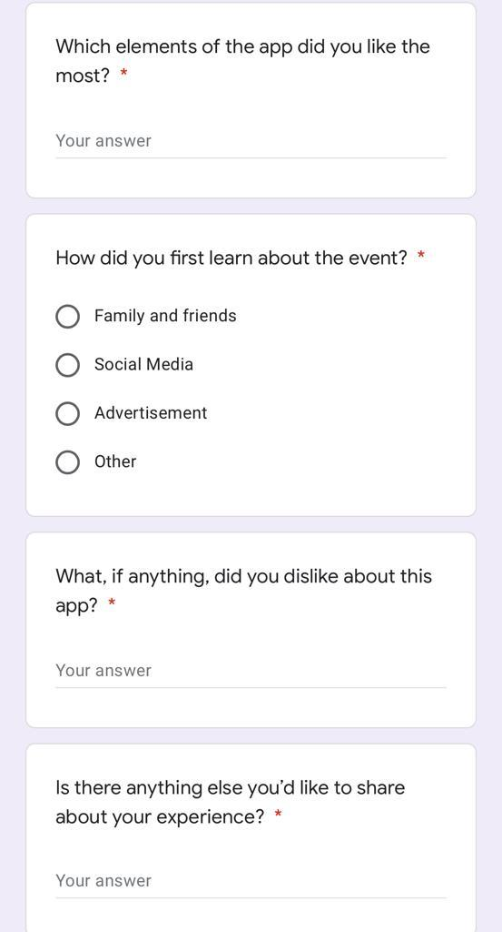
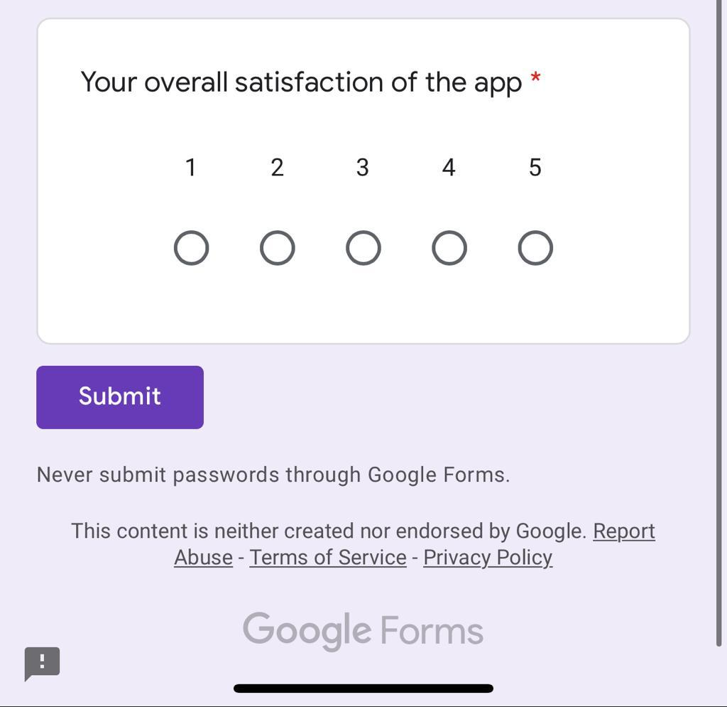

Slide 23
Concept Testing

Slide 24

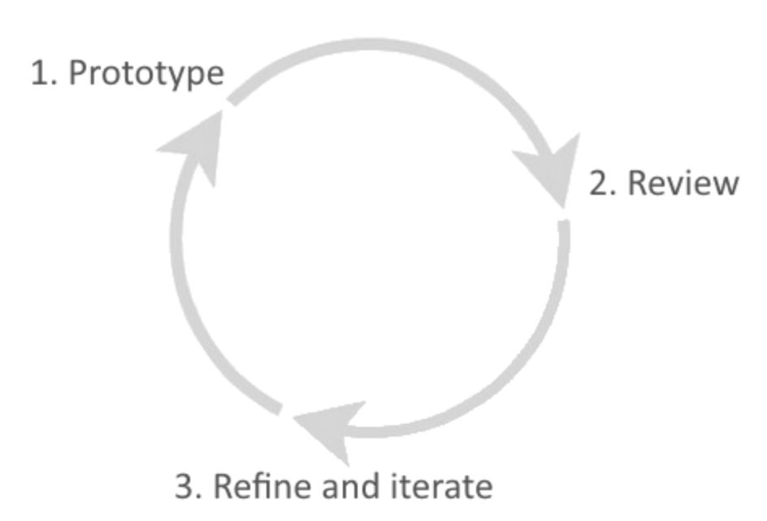
We conducted this to get feedback from the user on our idea in the early stages. The idea was communicated, and responses were addressed
The concept of VenYou was formed and after this it helped us jot down the requirements needed to move forward with the prototyping.
We spoke to a group of individuals and understood the most essential functionalities which would be required.
It helped us gain insight around whether customers understood the idea and would want to use the product or feature.

Slide 25
Card Sorting

Slide 26
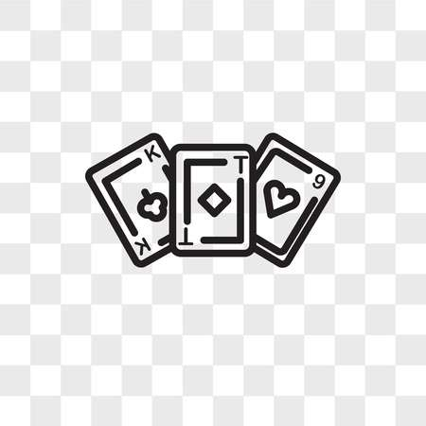
We applied card sorting technique to identify what users are expecting and want us to have in the App
It is used to develop the better and more user centric Information Architecture
We asked around 50 people in groups of 10 to take part in this usability testing method
Our cards consisted mainly of categorized items and scope of the application

Slide 27
Moderated User Testing

Slide 28
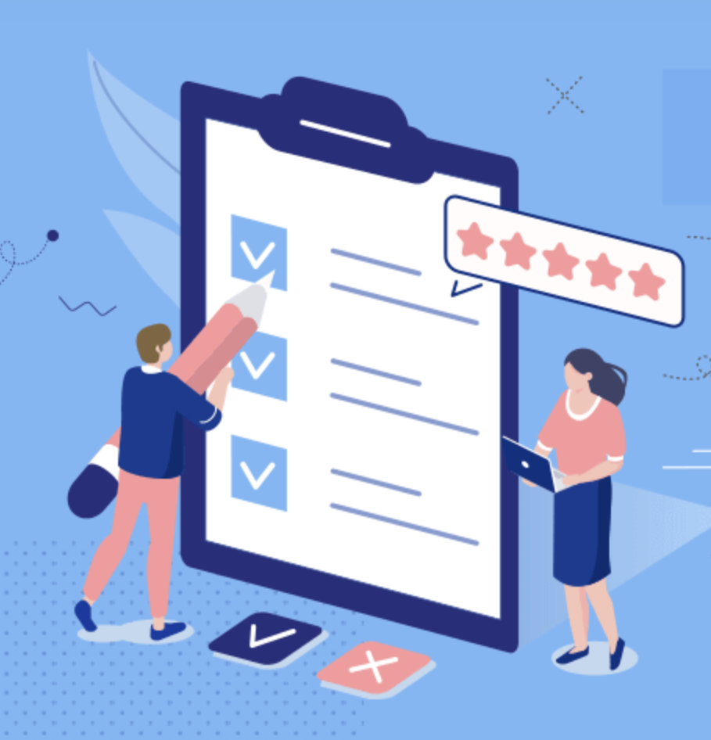
Moderated user testing was conducted to gain real time responses to the tasks the users were asked to perform.
The questions asked and responses received :
Journey was asked to be preformed:
Search an event
Find an event
Buy the ticket
How easy was it to register as a new user?
The process of creating a new user was really simple as we had to register with our gmail or social media accounts, thus helping us skip the process of having to fill out the personal details
What did you like about the event selection and categories?
The event selection ranged from conferences to concerts. The bifurcation in categories helps for easy navigation to find the desired events without having to navigate through the entire the application.

Slide 29
How easy was it to purchase the ticket? Would you like more options for payment than the ones specified?
Yes, The option to be able to pay with Apple Pay Card makes it really convenient for faster checkout. But it would be great to have an option to add a Debit/Credit Card, Venmo for personal preferences.
Would you like the option to buy more tickets than the tickets per person specified?
Yes, It would be great to be able to buy more tickets as the user could have more requirements, plus the exact amount is charged without any discount which should not cause any problem.
Any suggestions regarding the color scheme.
The color scheme works well with the event theme.

Slide 30

IBM Design Thinking

Slide 31
User Needs:
What do you need for your event? A ticketing system, event application, attendee engagement solutions, attendee check-out tools…Write down all you can think of.
What are the different strengths of the event planning app? Can one app cover all of your needs?
Is the event planning app mobile-friendly? Do they offer a website for your attendees too?
What are their reviews like in app stores and user communities?
How easily can you adopt them? Check if you can schedule a live demo or even test it out in advance.

Slide 32
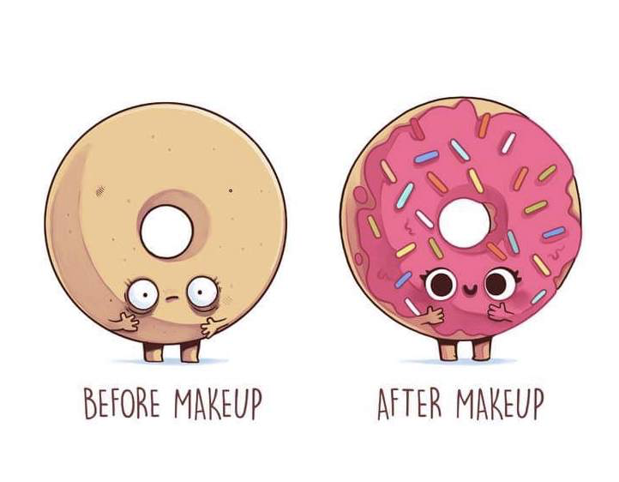
Existing Application
The applications currently available for Event Management do not provide the ease of creating the event and organising it as per their demand.
VenYou provides its customers personalized, exclusive event experience
We provide completely integrated solution, quick and easy ways to embed event checkout
VenYou allows you to take control of your brand and own the entire customer brand experience

Slide 33
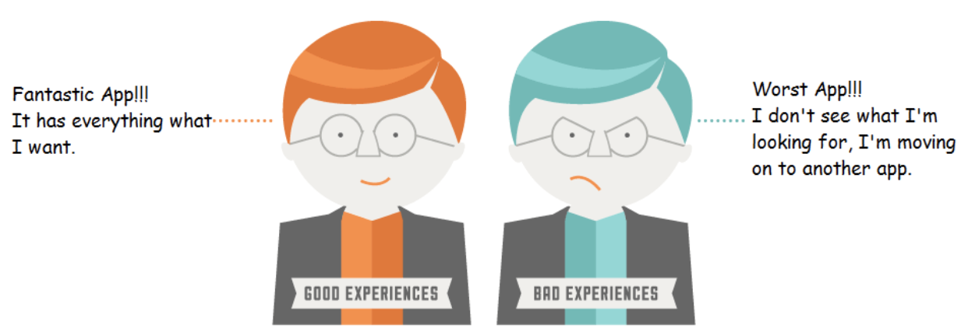
Focus on User Outcomes
You start with the customer, understand their wants and needs, and then wrap your service around that customer via relevant channels. No more pushing units to strangers. Efforts should be made by our app to change the business requirements as per the current trends and user requirements.

Slide 34
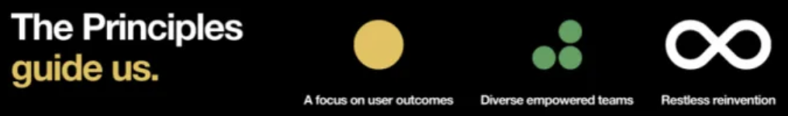
Multidisciplinary Teams
Diverse teams consisting of UX, Frontend, Backend, Business Analysts, PMs would not only generate ideas but would build foundation of mutual trust and respect.
Restless Re-inventions
VenYou is a unified platform where you can find everything about the latest events happening in your city.
You can sort the events based on time or type of event
You can add filters to make your search quick and easy
The user can create groups of people who they want to invite and invite a whole bunch of people at the ease of a button
The users can also share pictures and videos of the events and checkout the same uploaded by other attendees

Slide 35
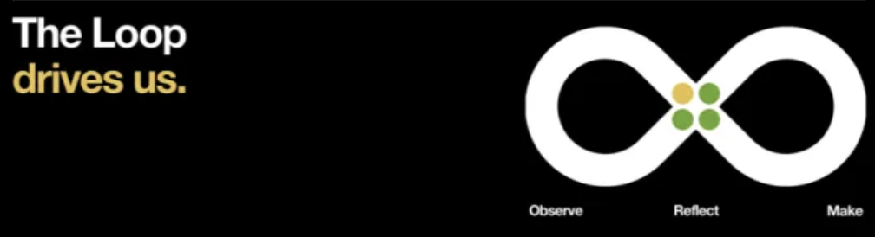
Observe
We tried to understand the users by asking for their problems and continuous feedback.
Reflect
Single platform not available for all needs
No freedom to organize event at user’s will
Paper wasted on ticket printouts
Cashless transactions not available for all events
Make
Everything is online
Cashless transactions
No paper wasted
Just use your phone and get your event organized

Slide 36
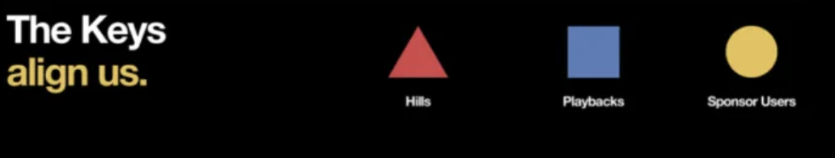
The Hills
Determine the who? What? And Wow?
For creating a product, there should be a team involved with different roles performing various actions. The Project Manager should be leading the team and delegate the work to other team members such as frontend, backend, BA, etc.
Playbacks
It involves conducting meetings and sessions with the team to share the progress of the product development. Analyze various models for development like the event booking model, event search model and create a prototype for the same.
Sponsors Users
Get a real user on the team, allow him/her to see and observe the product demo and also participate in the entire development process. Everyone should be contributing ideas for the product/ feature. In our whole app development process, TAs were thoroughly involved.

Slide 37

Style Guide
Our Logo
Our logo is the combination of a simple and modern wordmark with the icon that speak to all sorts of event organizers, as well as attendees.
Given the nature of the events organized, this logo is a powerful design.

Slide 38
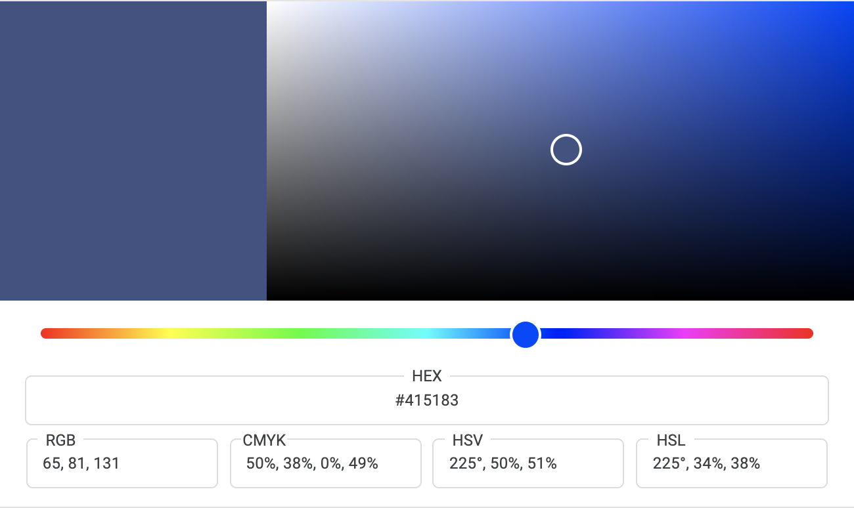
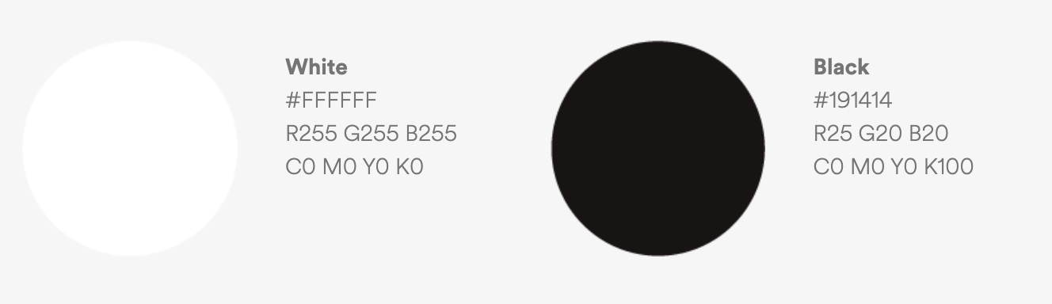
Our Colour
While embracing a much more colourful language in our brand communications with blue is our primary colour which can be seen as elegant, rich, sophisticated.

Slide 39
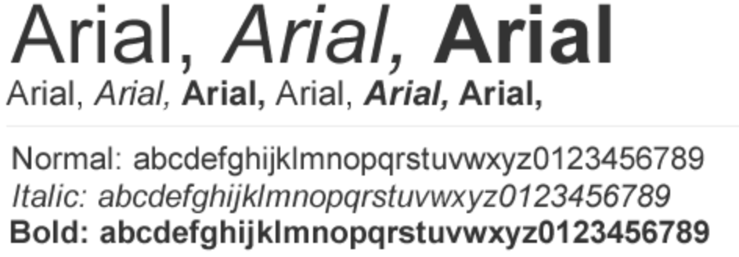
Typography
We have used Arial which come from sans-serif font family. It acts as neutral but is contemporary. It is clean, straight-forward and futuristic.
For the main headings(H1), we have used font size as 24 and 20,18,16 and 14 for sub-headings and content. To emphasize the text, we have used bold property.

Slide 40
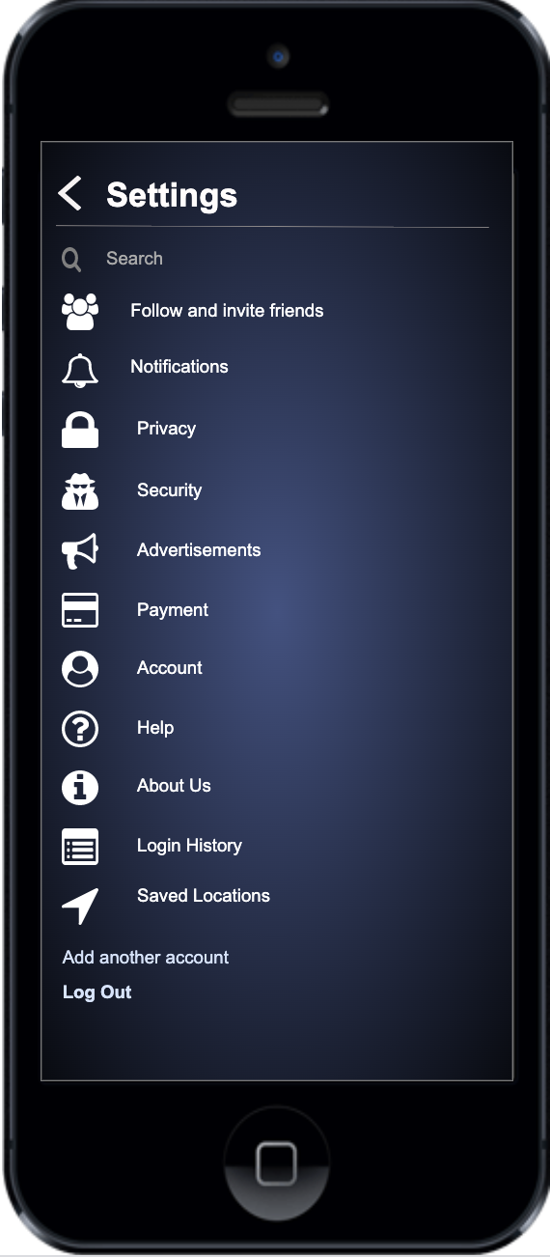
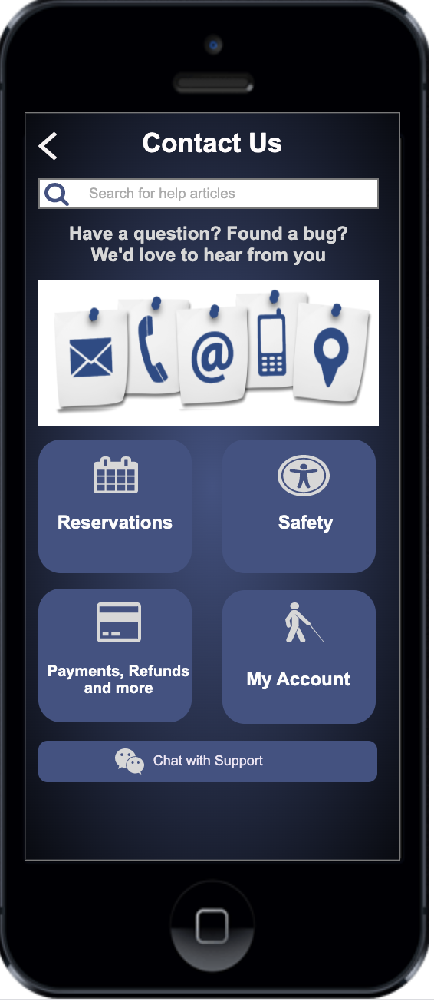
Icons
Icons enables clear and instantaneous communication for information graphics. In most cases the icons need to be supported by text (and must/cannot speak for themselves). Use the icons for information, never for decoration or as logotypes.

Slide 41
App Icon
To maintain a consistent and uniform look for applications, our icon is present on iOS as shown below.
The templates are built on a grid system including the Venyou wordmark. The primary colours are used as base, with black and bluish-purple as the default colours

Slide 42
App Name
As the name is pronounced as “venue” and this app is all about finding an event, that’s why we chose our app name as VenYou i.e venue for you.
We kept it short and upto the core with less than 10 characters. It also focuses on the functionality of the app.
We avoided fabrication and elaboration of words and symbols.

Slide 43
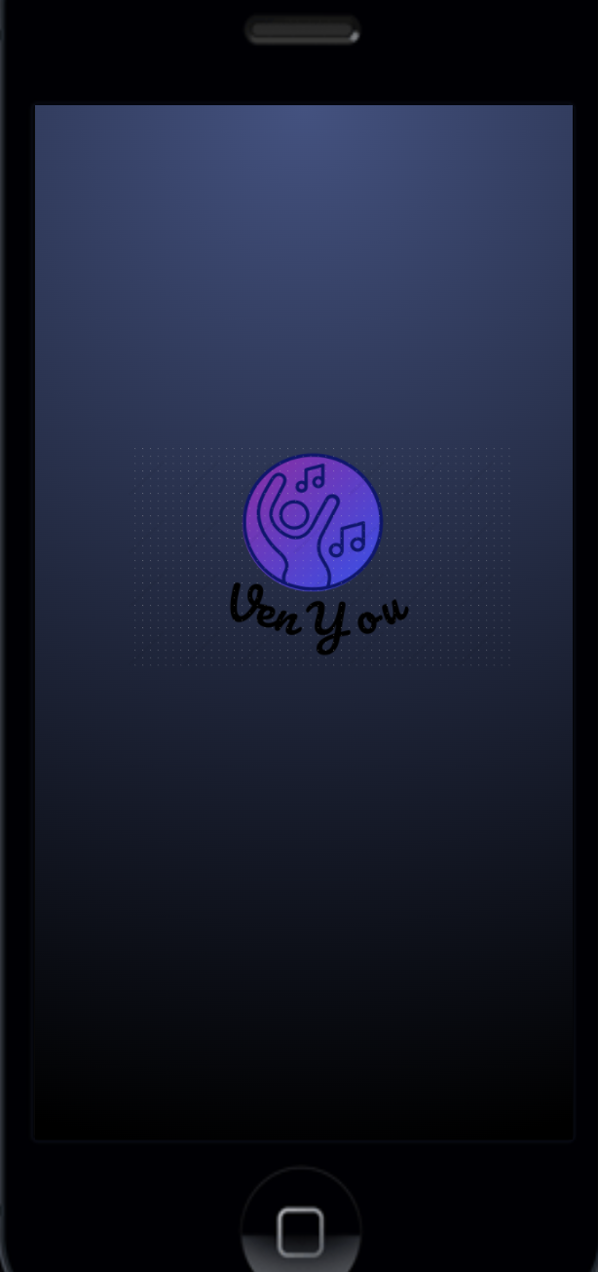
Splash Screen
The purpose is to create a uniform and consistent look for our application. The primary palette is used as a base with faded blue and black as the default colours.
The secondary app colours can be used in certain context where more variation is needed.
Colours used in splash screens should co-relate with colours used inside the app.

Slide 44
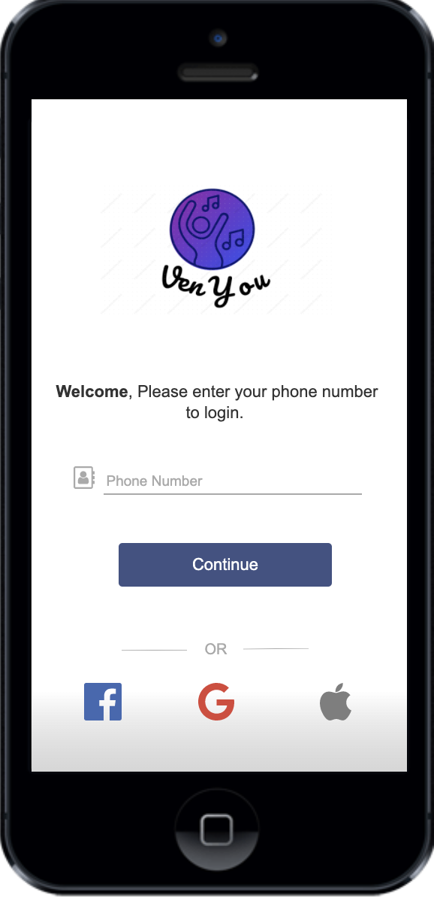
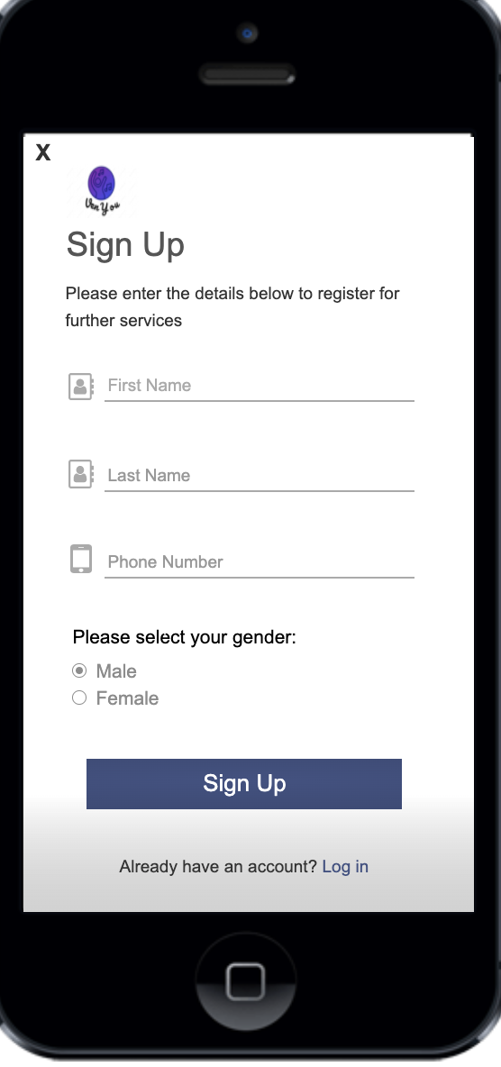
Screenshots

Slide 47


